Slide 1








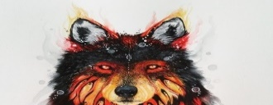
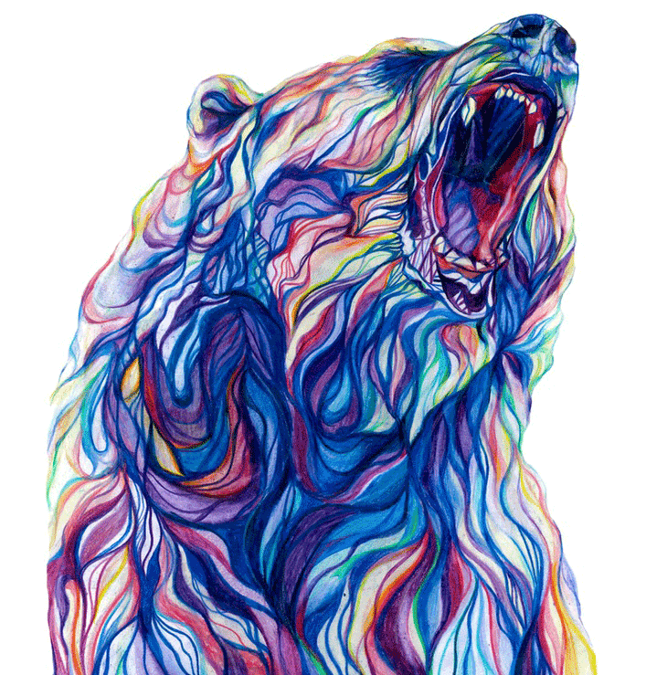




Art Mode
Home
Art Mode
Today
Trending
News
Art Mode
ART OF THE DAY
DELINEATE
YOUR FUTUTRE WITH YOUR
CREATIVITY
View more >>
USERNAME
PASSWORD
Space Time
Forgot Password?
Mr. Daisy
4,567
56,789
FEATURED
SIGN UP
LOGIN
View more >>
LOGIN
SIGN UP

Slide 2


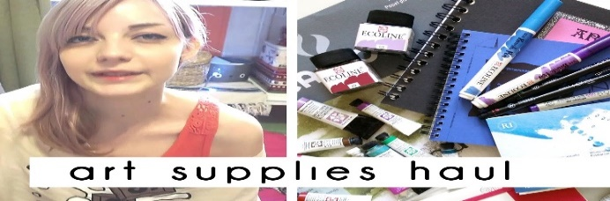



Home
Home
Notes
.
.
.
Art Mode
Art Mode
Art Mode
Today
Trending
News
Today
Trending
News
Notifications
Messages
Ashiyaart Art Tips
Cologne Says it wants a Gerhard Richter Museum. But he said he doesn’t need one
Friday, August 2 2019
View more >>
Ashiyaart liked your photo
By: Kate Brown
Details >>
Kawanocy liked your photo
Ashiyaart
12,678
45,679
DRAW THIS IN YOUR STYLE CHALLENGE
Who is the Mysterious Consortium that owns a supposed younger version of ‘Mona Lisa’?
View more >>
By: Kate Brown
Details >>

Slide 3





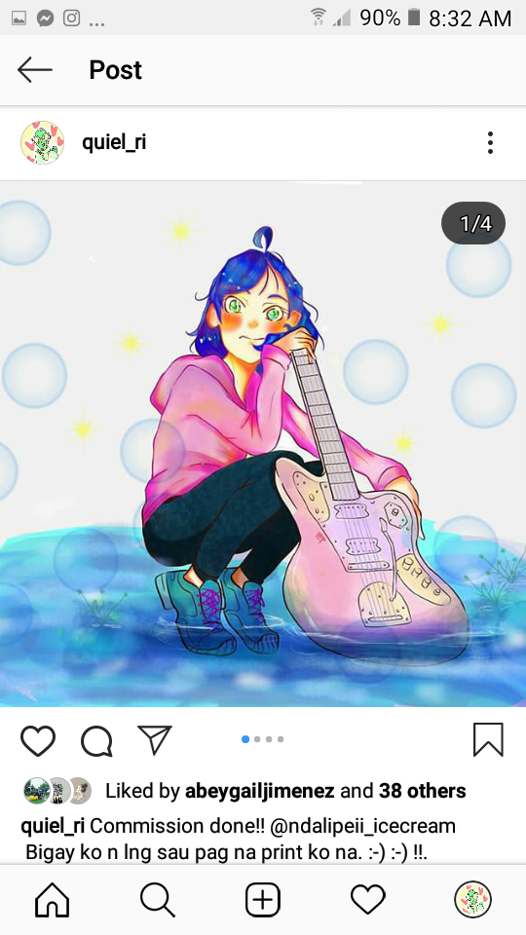



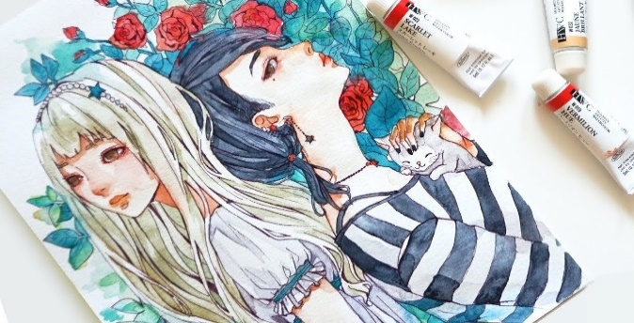



Notes
.
.
.
Messages
Erika24
Art Mode
Art Mode
Art Mode
Notifications
Messages
Kawanocy
Followers
Following
5,678
34
Friday, August 2 2019
Kawanocy: Nice one! I kind…..
KrookedGlasses: Don’t like it..
Ashiyaart: Pretty much . But I..
Posts
Likes
Ashiyaart
>

Slide 4



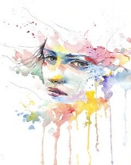
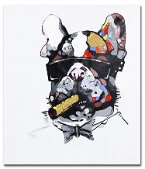

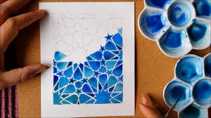



All Photos
Profile
Art Mode
Art Mode
Art Mode
TEXT
NEXT >>
E-MAIL
Create your account now!
USERNAME
SIGN UP
PASSWORD
CONFIRM PASSWORD
SIGN UP
OR SIGN UP WITH
LOGIN

Slide 5


Home
Ashiyaart liked your photo
Art Mode
Art Mode
Home
Today
Trending
News
Today
Trending
News
KrookedGlasses: Don’t like it..
Ashiyaart Art Tips
#Tips #HowTo
Cologne Says it wants a Gerhard Richter Museum. But he said he doesn’t need one
View more >>
Log In or Sign Up first in order to do this action.
By: Kate Brown
Details >>
Ashiyaart
12,678
45,679
DRAW THIS IN YOUR STYLE CHALLENGE
Who is the Mysterious Consortium that owns a supposed younger version of ‘Mona Lisa’?
View more >>
By: Kate Brown
Details >>

Slide 6
PRINCIPLES
Art Mode is an application made for the people who wants to showcase their artistic self to the world. This application is not only for showcasing artistic works but also to show to the users the trends, the latest news about art world and more stuffs related to art. Users also can communicate with other users so that they can share information’s and do collaborations with them.
This application is not for all ages (only for 18+ and above) because there are some art works, news articles that are not for children, that they may not understand.
For the design I used other applications such as deviant art and tumblr as my guidelines, the color palettes they’ve used are not painful to the eyes but pleasing, I do changed some of the colors and some arrangement in order to avoid copyright. As you can see I keep trying to make it look consistent and I don’t add too much button so that the users won’t get confused.
Users can explore the application even though they are not members nor part of it, but if they try to post, like or chat it will dim and a pop up will appear and remind them that they need to sign up first in order to do that and if they click the profile button and still not a member they will see a text and a button to create an account.
If the user is a member or already log In to the application there notifications that will appear if someone like, comment, or a latest news come up.

